Slide 1

Basics of Data Science and its Career Opportunities
Neha Baranwal

Slide 2
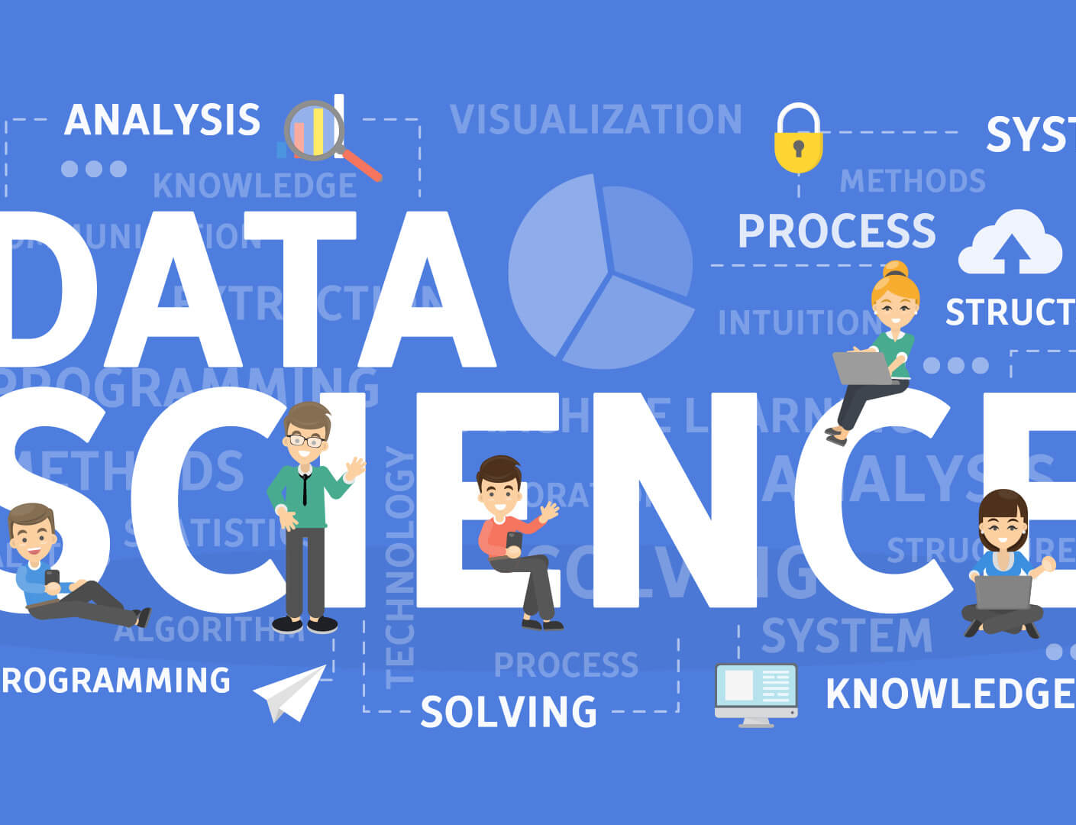
Definition
Data Science is the study of data to extract meaningful insights for business

Slide 3

Some other definitions
Data science = statistics + data processing + machine learning + scientific inquiry + visualization + business analytics + big data + …
Data science is the application of computational and statistical techniques to address or gain insight into some problem in the real world

Slide 4
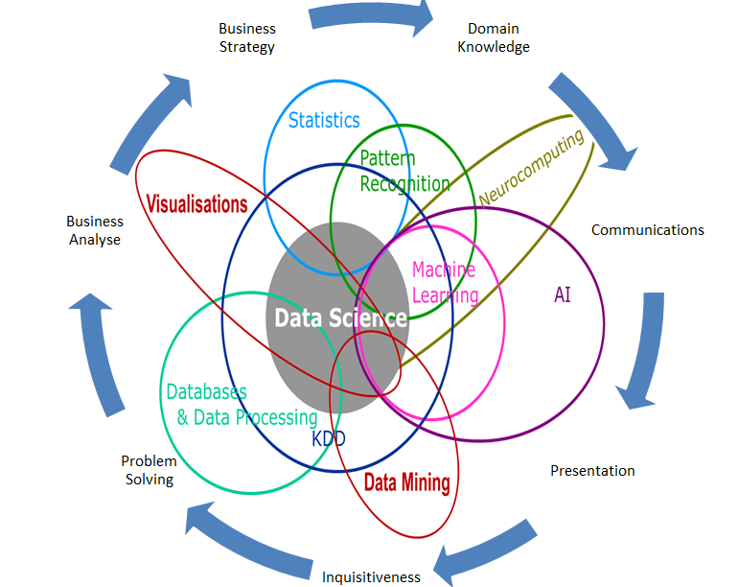
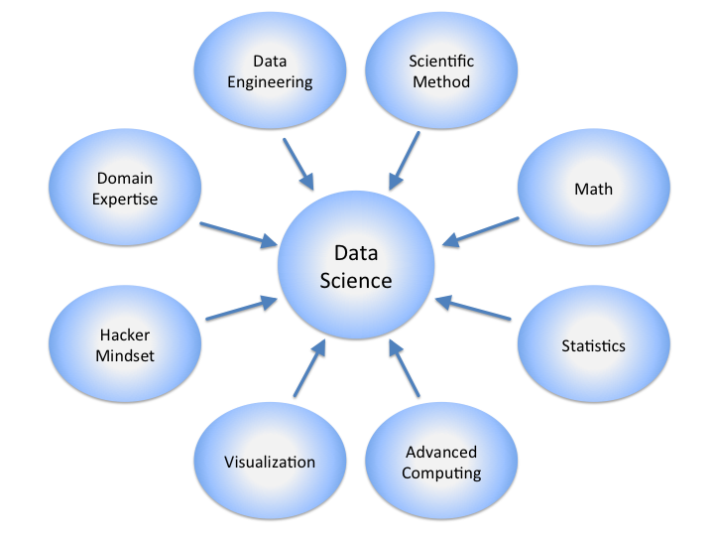
Data Science is Multidisplinary

Slide 5
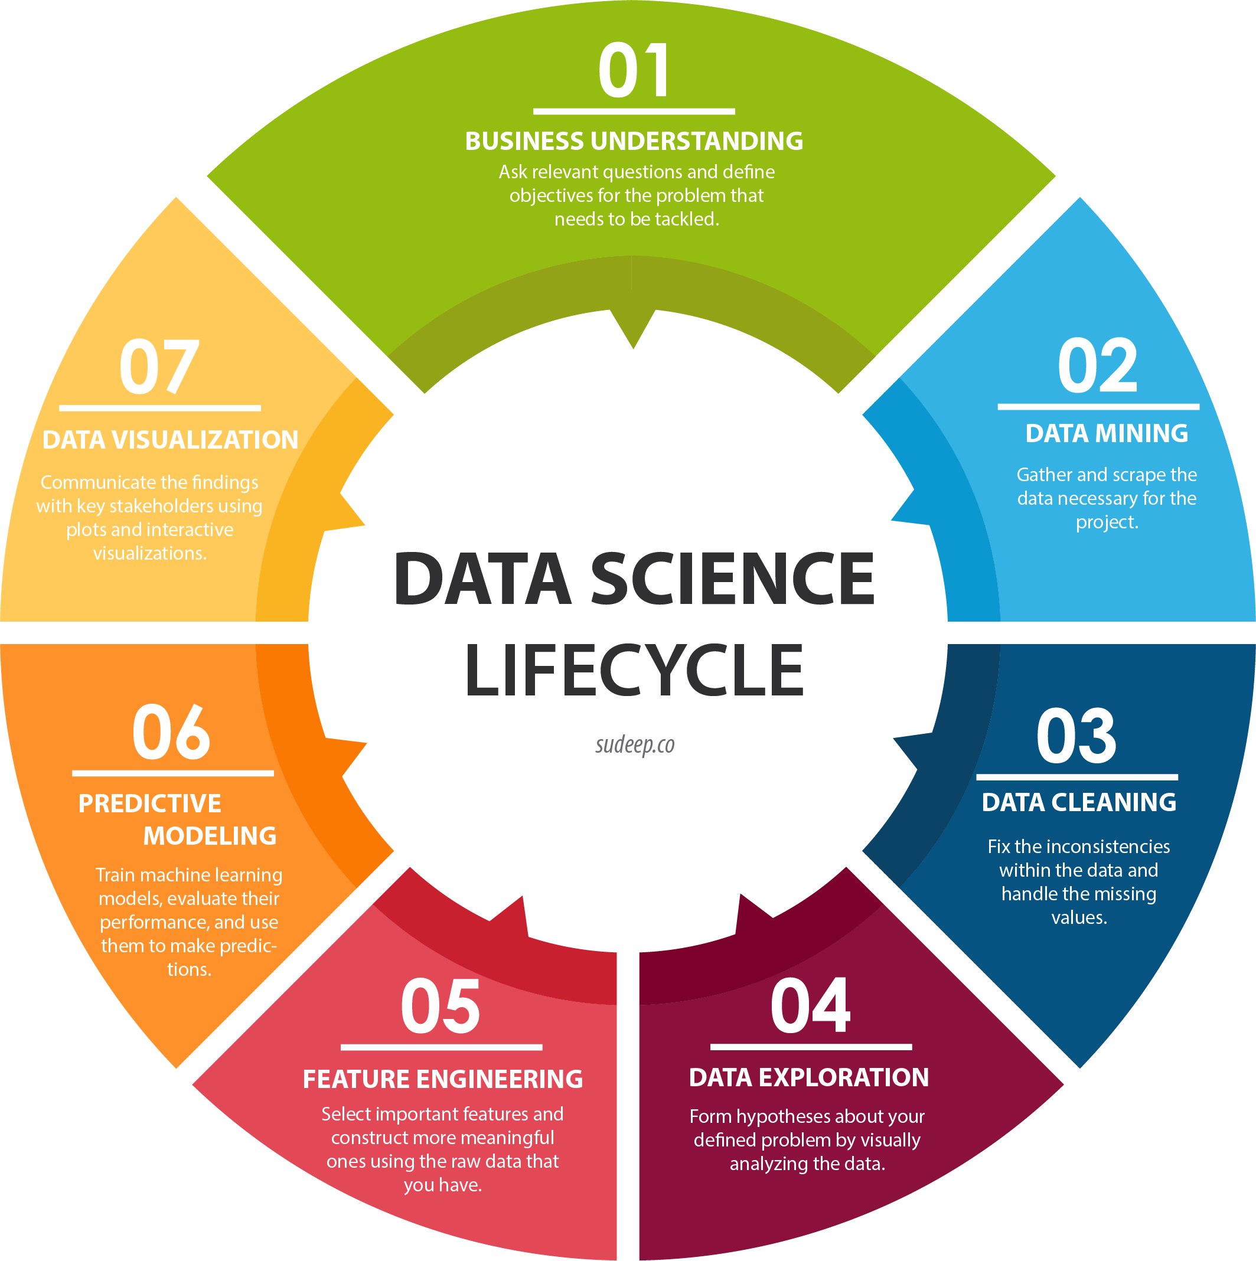

Slide 6
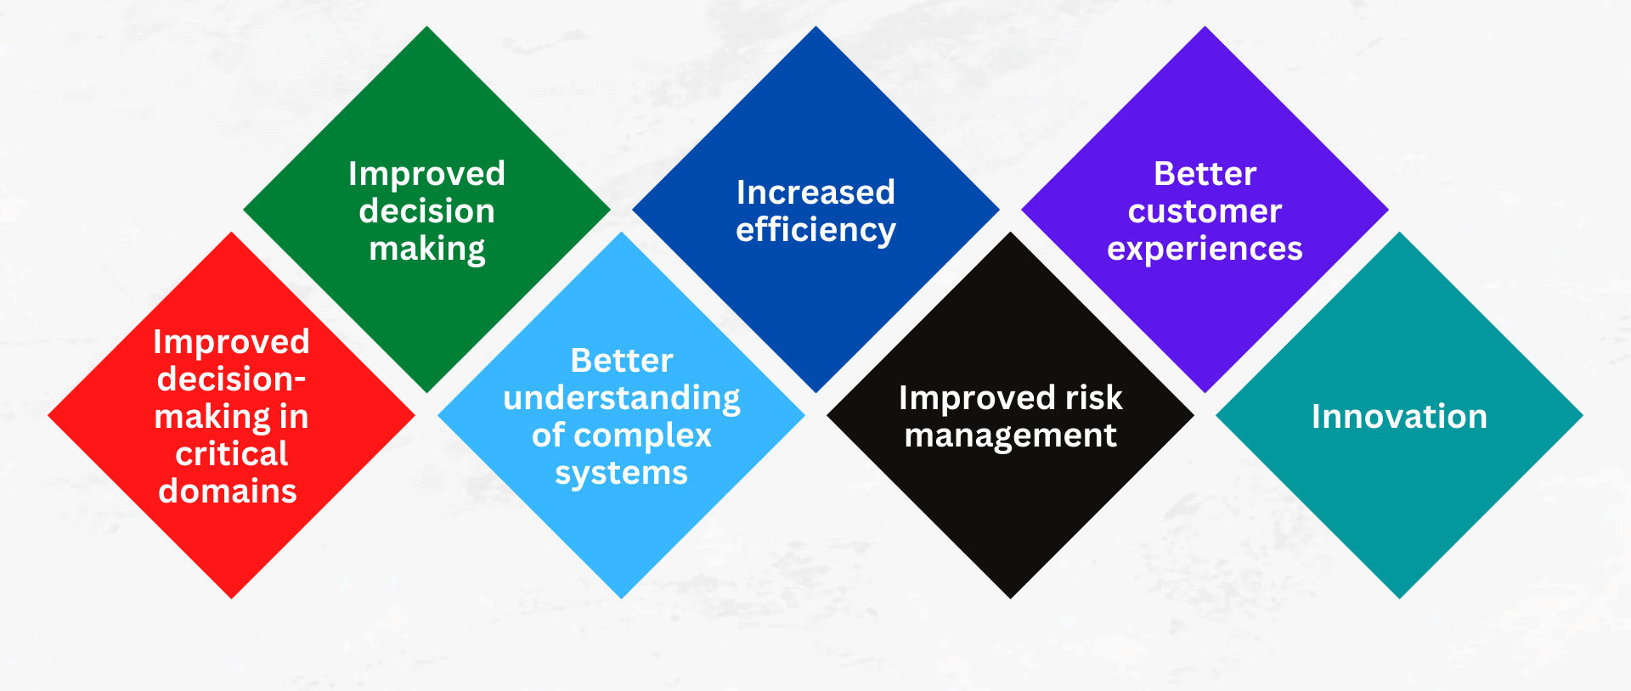
Why data science is important

Slide 7

Data Scientists
Data Scientist
The Sexiest Job of the 21st Century
They find stories, extract knowledge. They are not reporters

Slide 8
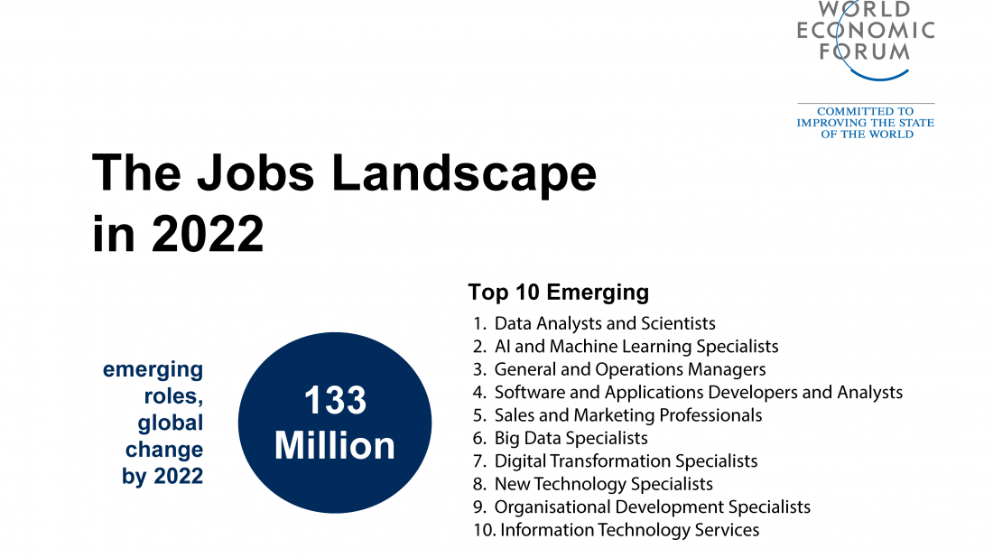

Slide 9
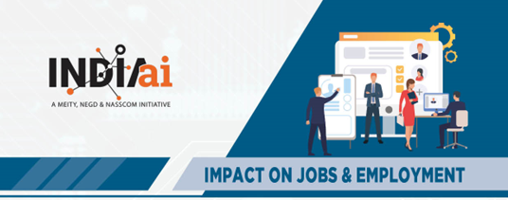
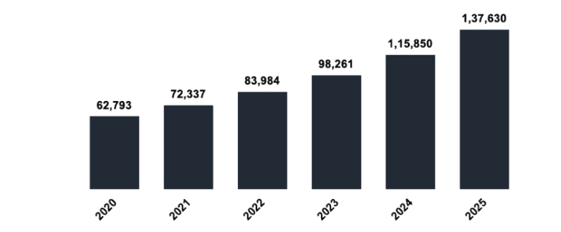
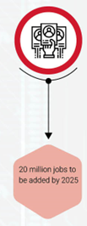




Data Science Jobs(Analytics Insight)

Slide 10
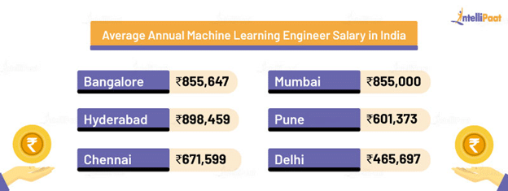
Average Annual Salary

Slide 11
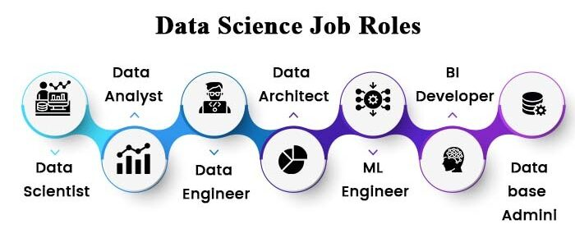

Slide 12
AI Helping in Different Industries
Healthcare: Proper diagnosis and treatment are facilitated by introducing AI in healthcare.
Education: A suitable learning environment is furnished to the students by utilizing AI.
Sports: With advanced AI technologies, athletes can expand their capabilities.
Agriculture: Maximum yield is possible by AI as it helps in developing the perfect farming environment.
Construction: Buildings can be constructed more safely and efficiently by the incorporation of AI.
Banking: Chat-bot assistance, fraud detection, and enhanced payment methods are some of the positive outcomes of AI.
Marketing: The sales target can be effectively achieved by making use of predictive intelligence along with machine learning.
E-commerce: Effective warehouse operations, good product recommendations, and fraud prevention are some of the fruits of AI.

Slide 13

Data Science: Case Study: Elections
The Obama campaigns in 2008 and 2012 are credited for their successful use of social media and data mining.
Micro-targeting in 2012
– http://www.theatlantic.com/politics/archive/2012/04/thecreepiness- factor-how-obama-and-romney-are-getting-to-knowyou/255499/
– http://www.mediabizbloggers.com/group-m/How-Data-and- MicroTargeting-Won-the-2012-Election-for-Obama---Antony- YoungMindshare-North-America.html
Micro-profiles built from multiple sources accessed by aps, realtime updating data based on door-to-door visits, focused media buys, e-mails and Facebook messages highly targeted.
1 million people installed the Obama Facebook app that gave access to info on “friends”.

Slide 14
Data Science: Case Study Customer Analytics

Slide 15
Data Science: Case Study Cancer Research
Cancer is an incredibly complex disease; a single tumor can have more than 100 billion cells, and each cell can acquire mutations individually. The disease is always changing, evolving, and adapting.
Employ the power of big data analytics and high-performance computing.
Leverage sophisticated pattern and machine learning algorithms to identify patterns that are potentially linked to cancer
Huge amount of data processing and recognition

Slide 16
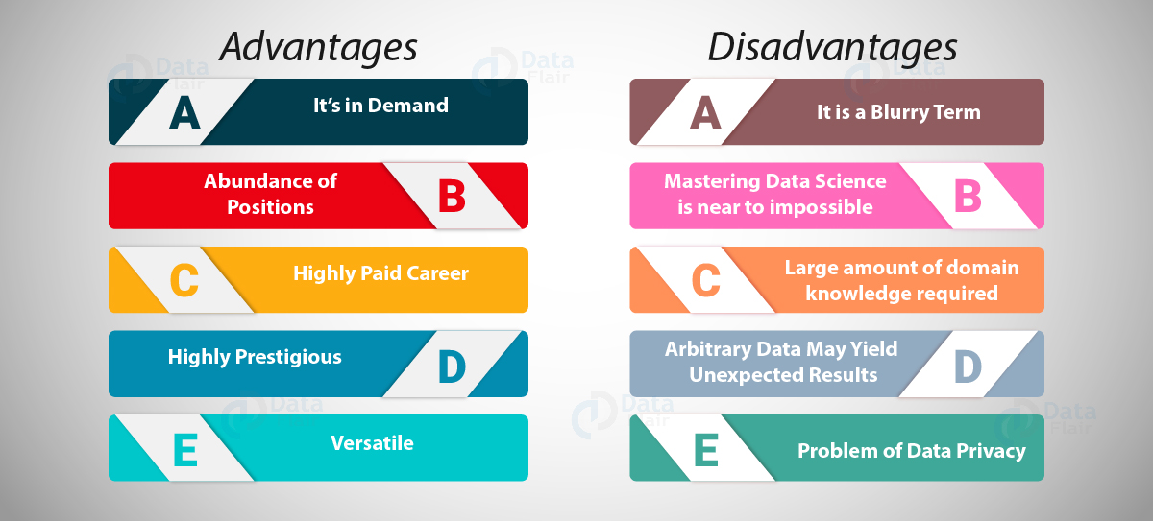
Advantages and Disadvantages

Slide 17
Course Structure
Foundations of Data Science
Advanced Data Science Techniques
Advance Topics & Applications
Capstone Project

